Slide 1

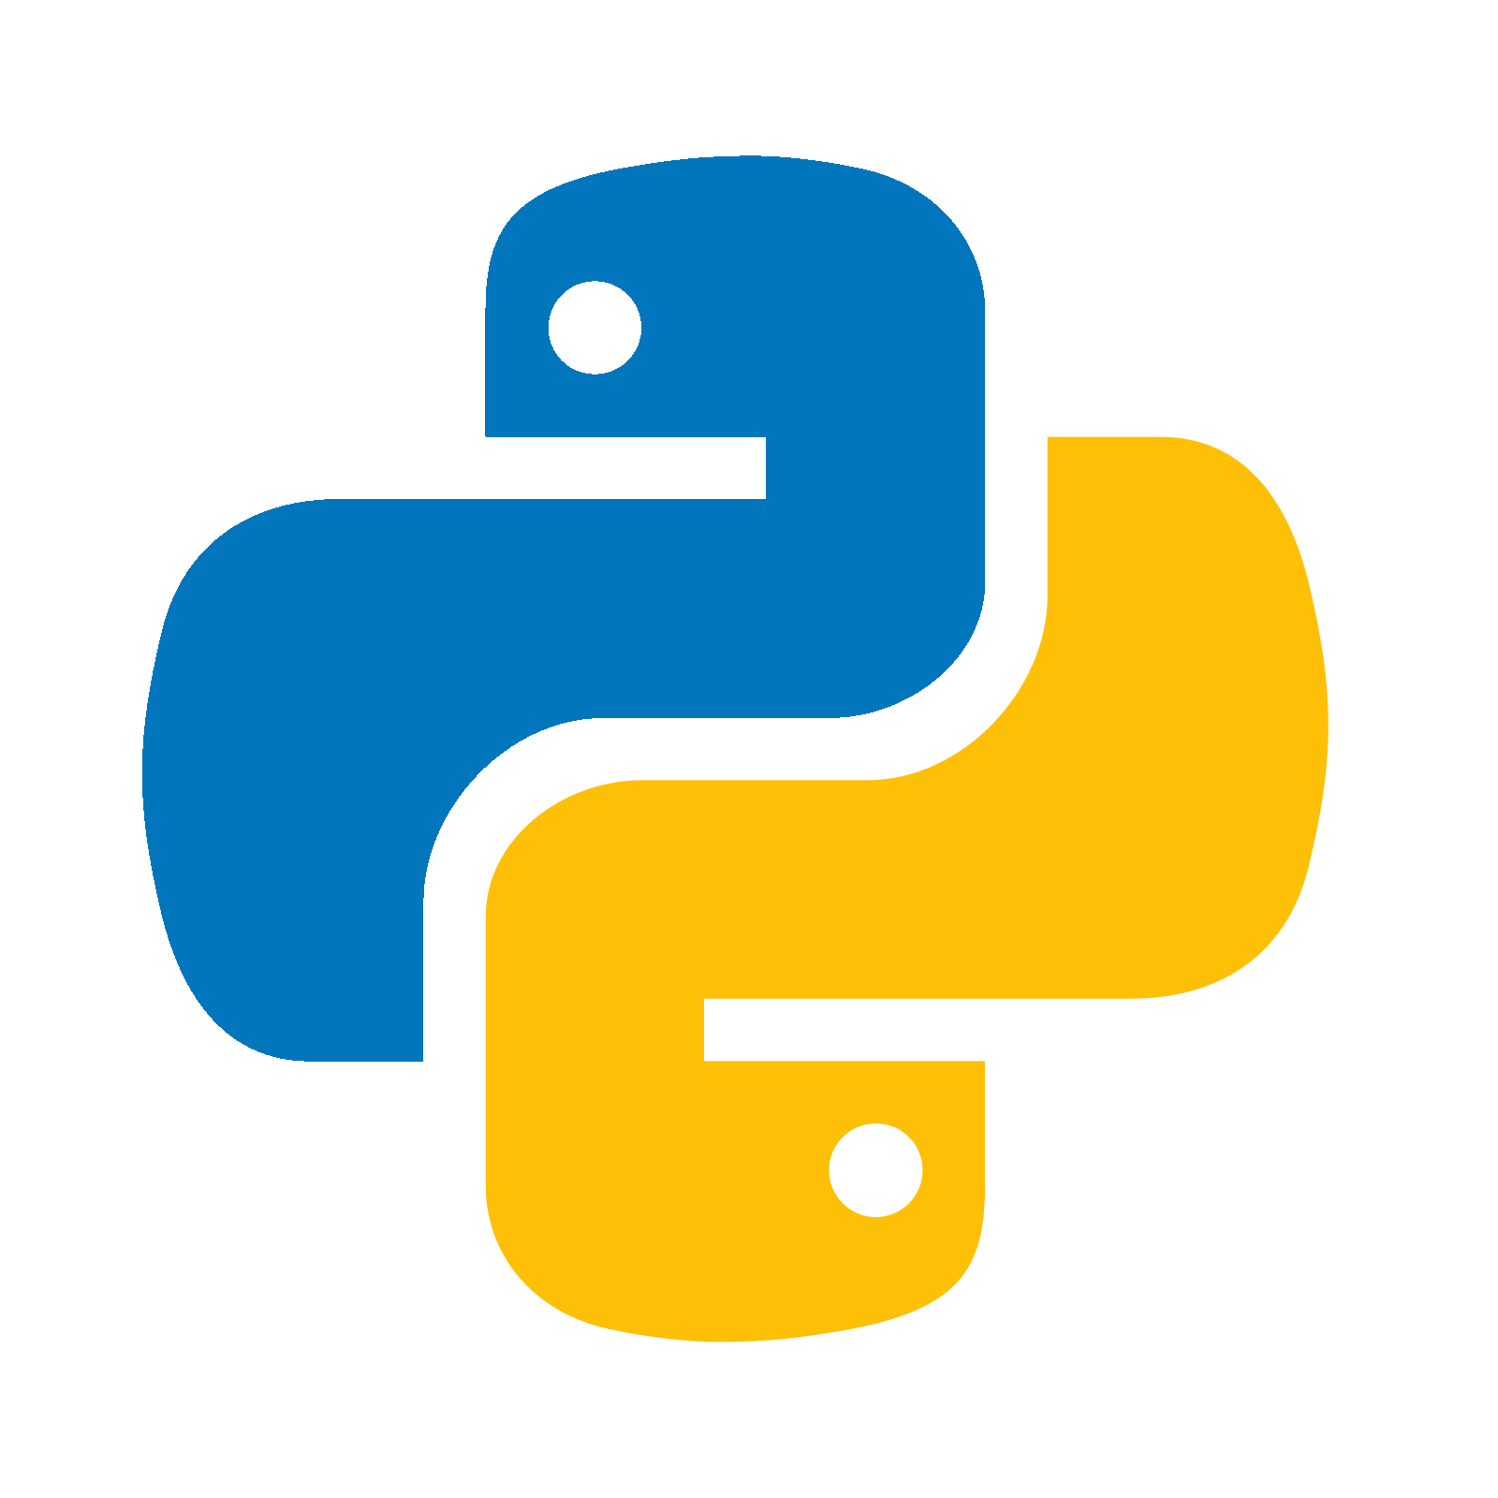


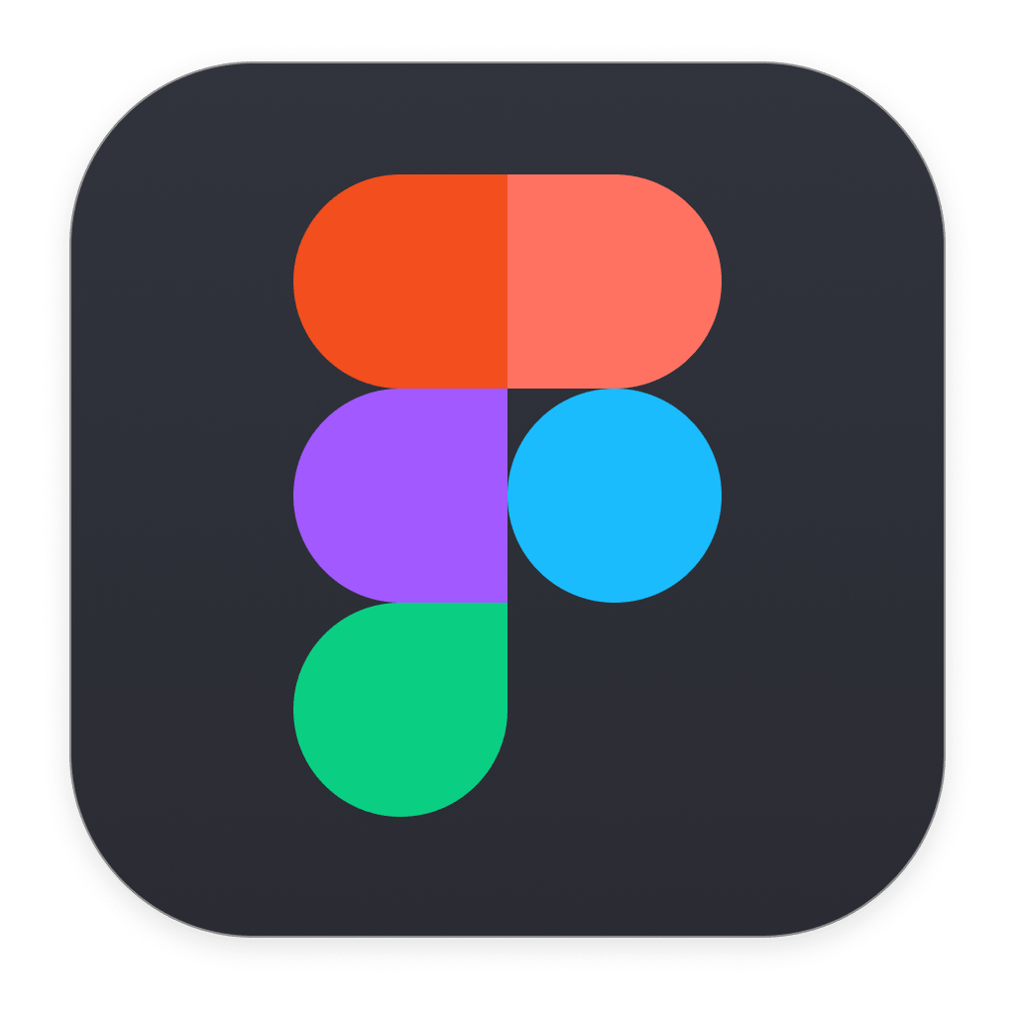
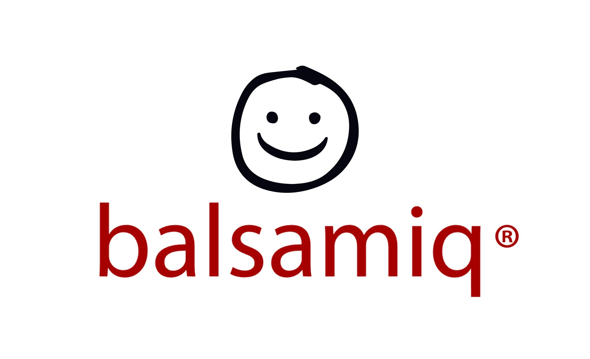

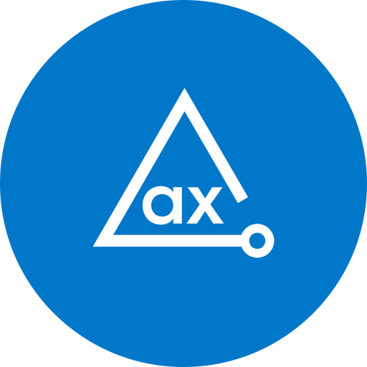
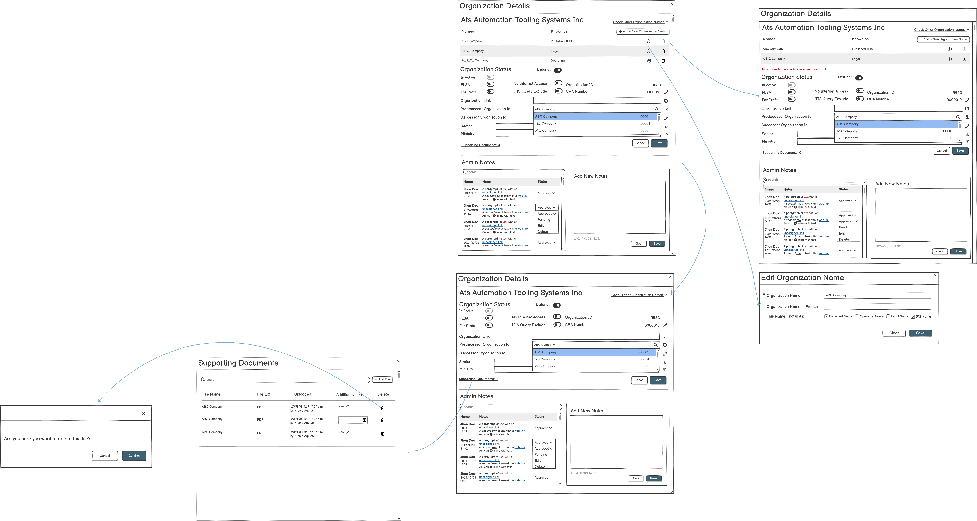


About OPS
The Ontario Public Service (OPS) delivers public services across healthcare, education, and public safety.
I worked in the CAC QA department under the Treasury Board Secretariat, focusing on quality assurance and accessibility to support inclusive digital services.
COOP in OPS as UX-Designer
Techniques I used
Key Contributions
AODA Compliance: Did AODA testing for three systems, AI&AODA research
UI/UX Testing: Generated detailed reports that drove interface optimizations.
System Redesign: Collaborated with developers to enhance efficiency and appeal.
Automation Tool: Streamlined screen reader testing with Python and AutoIt.
Student Name: Xuefei Ma
Academic Concentration: User Experience Design
Co-op Company Name: Ontario Public Service
Job Title: Co-op UX Designer
Co-op Term: 2024/9 - 2024/12
Outcome
Lessons Learned
Understand accessibility standards like AODA thoroughly before making design or testing changes.
Collaborating with team members and sharing ideas improves understanding and outcomes.
Don’t hesitate to ask questions or propose new ideas—it fosters innovation and clarity.
Keeping detailed notes and logs helps with task management and reflection.
Seeking feedback regularly ensures continuous improvement in both design and communication.
It’s okay to admit limitations and adjust expectations for complex tasks.
Deadlines may seem daunting, but efficient planning makes them manageable.
“As a Co-op UX Designer, My role is focused on AODA compliance, UI/UX testing, and system redesigns.”

